Slide 1
Charity Giving Database
Presented By
Thet Zin (Software Development Stream)
24/03/2023

Slide 2
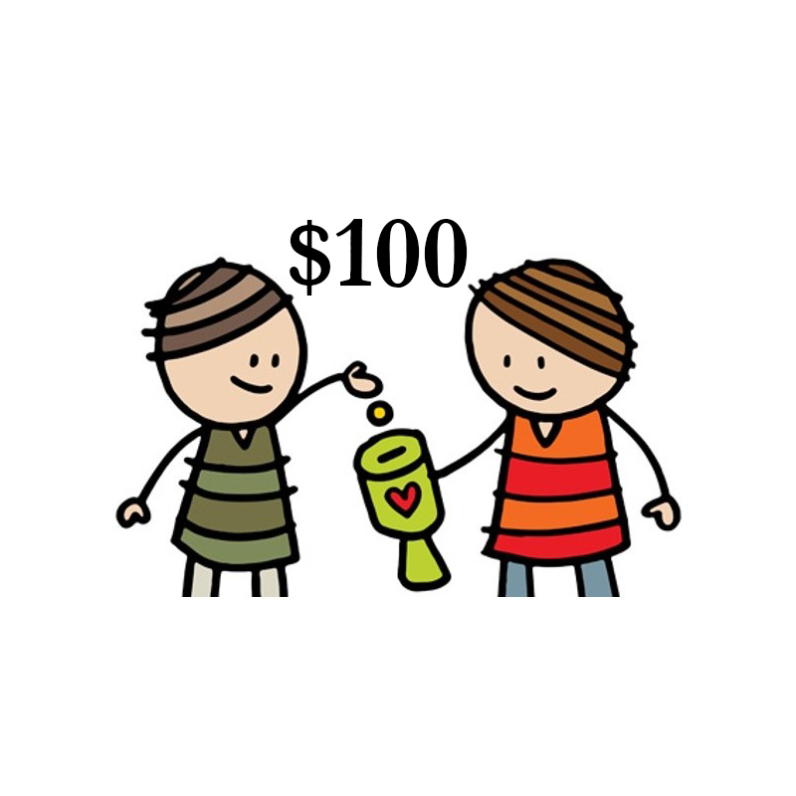
Agenda
Scenario
How it works
Tools used
Demonstration
Future Improvements
Reflection Session

Slide 3
Scenario
Pool donations and distribute
Beneficiaries - organizations, people, events

Slide 4
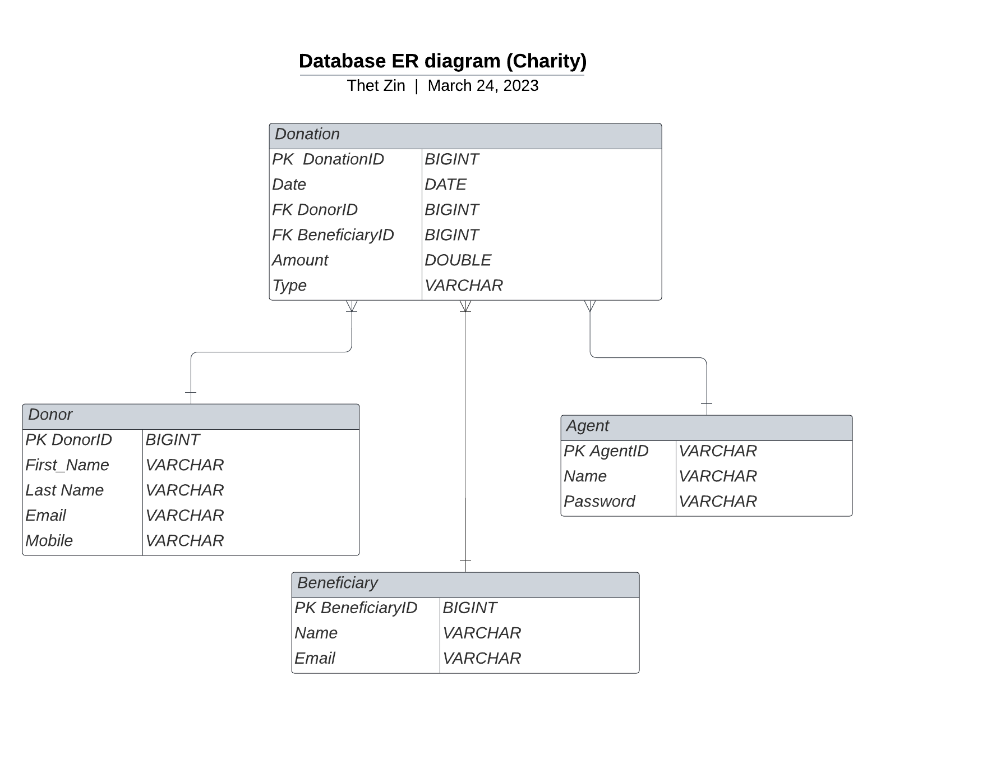

Slide 5
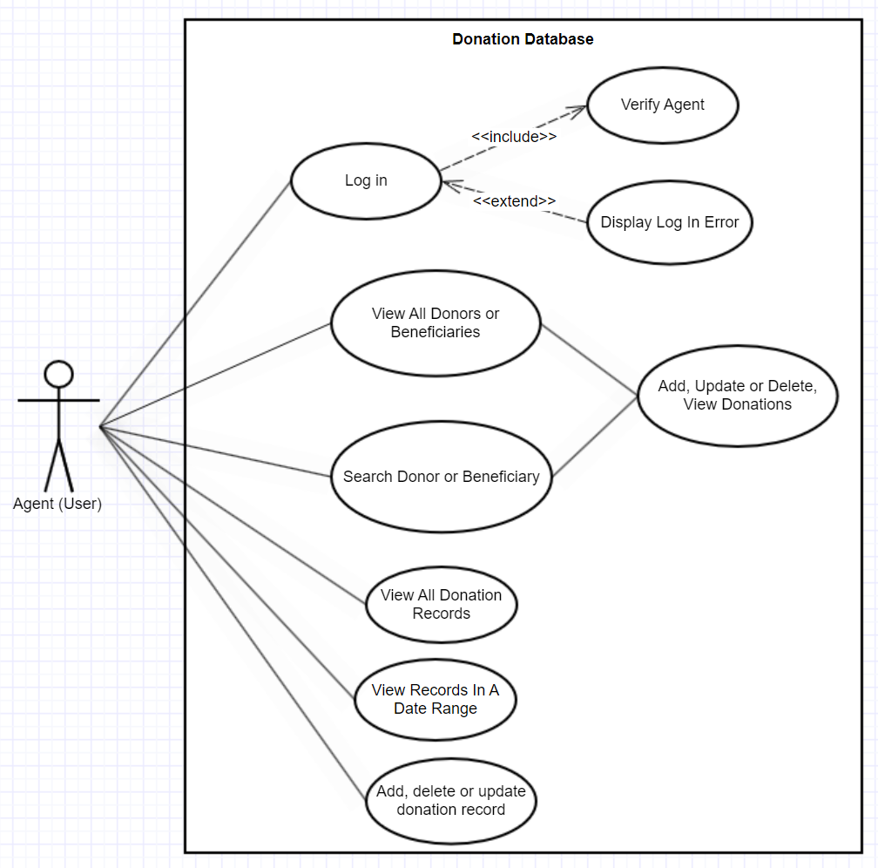

Slide 6
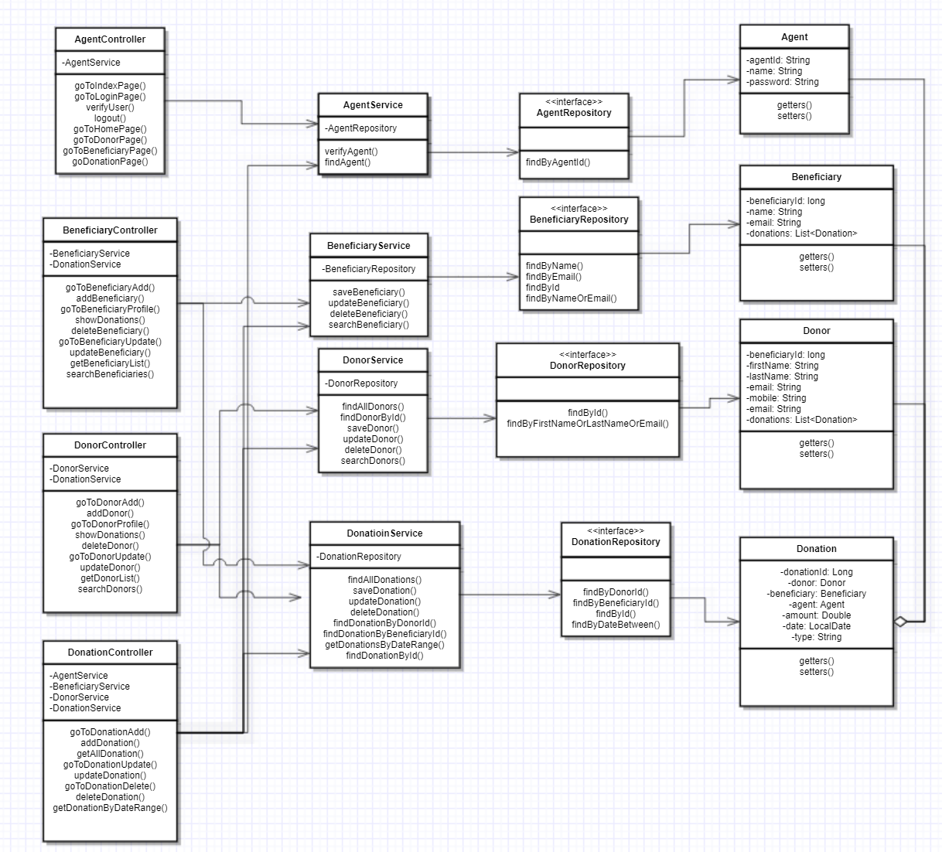

Slide 7




Tools Used

Slide 8

Demonstration

Slide 9
Future Improvements
Security
UI
Summary Page
Balance Statement

Slide 10
Reflection
Importance of Version Control
To be more comfortable with TDD
To develop good coding practices

Slide 11
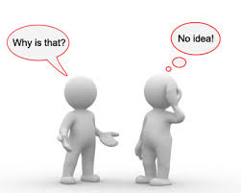
Q and A Session

Slide 12


